Slide 1
STEM CELL

Slide 2
History
1998 - Researchers first extract stem cells from human embryos
1999 - First Successful human transplant of insulin-making cells from cadavers
2001 - President Bush restricts federal funding for embryonic stem-cell research
2002 - Juvenile Diabetes Research Foundation International creates $20 million fund-raising effort to support stem- cell research
2002 - California started stem cell research
2004 - Harvard researchers grow stem cells from embryos using private funding
2004 - Ballot measure for $3 Billion bond for stem cells

Slide 3
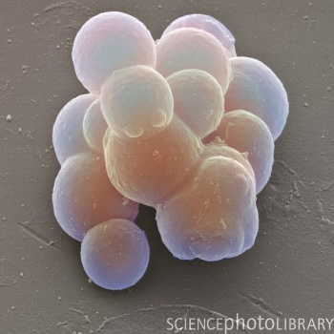
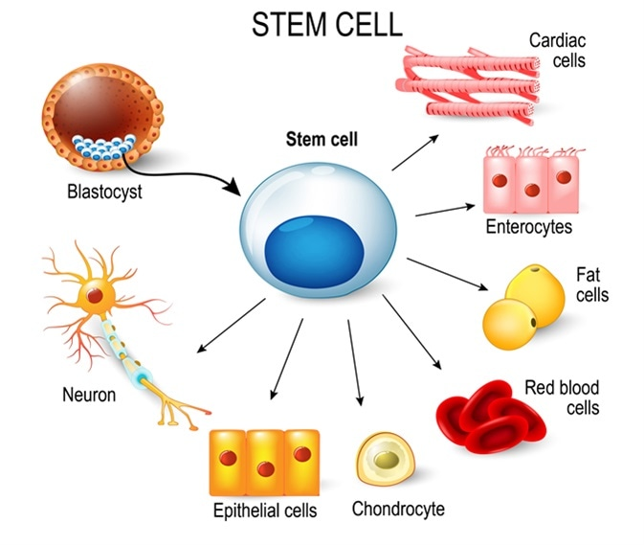
Introduction to Stem Cell
Human body is made up of many specialised cells that perform specific functions
Specialised cells arise from the differentiation of unspecialised cells (stem cells) during embryological development.
Stem cells are unspecialised cells that have the ability to reproduce and differentiate into a diverse range of specialised cells
Definition:
A cell that has the ability to continuously divide and differentiate (develop) into various other kind(s) of cells/tissues

Slide 4
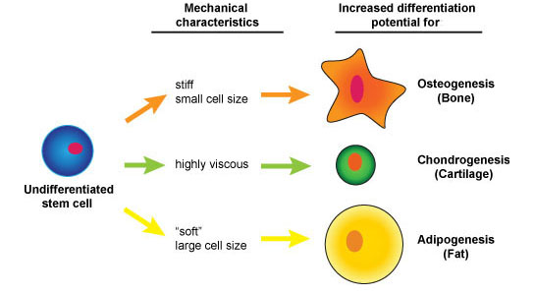
Characteristics OF Stem Cell
‘Blank cells’ (unspecialized)
Capable of dividing and renewing themselves for long periods of time (proliferation and renewal)
Have the potential to give rise to specialized cell types (differentiation)

Slide 5
Features of Stem Cells
Stem cells are very unique cells
Amazing ability to develop into several distinct cell types in the body
It can be used as a repair system for the body
It can theoretically divide without limit in a living organism in order to replenish various types of cells
When a stem cell divides, each new cell has the potential to either remain a stem cell or become another type of cell with a more specialized function (i.e. a muscle cell, a red blood cell, a brain cell, etc.)

Slide 6
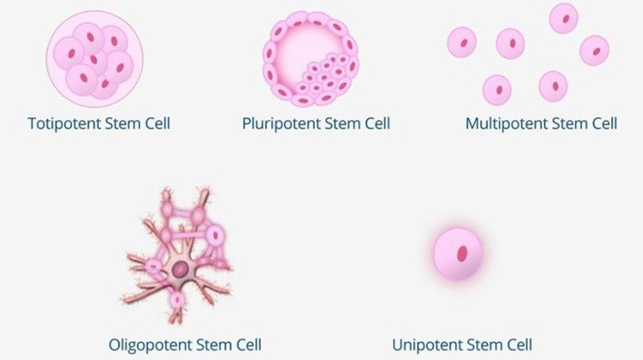
Types of Stem Cells
Stem cell type | Description | Examples
Totipotent | Each cell can develop into a new individual | Cells from early (1-3 days) embryos
Pluripotent | Cells can form any (over 200) cell types | Some cells of blastocyst (5 to 14 days)
Multipotent | Cells differentiated, but can form a number of other tissues | Fetal tissue, cord blood, and adult stem cells

Slide 7
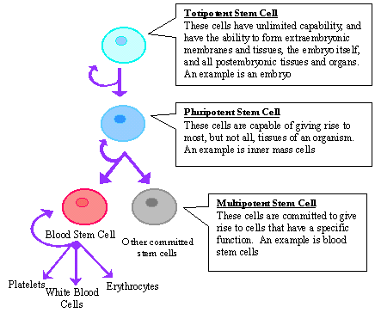
Stem Cell Differentiation

Slide 8
Types of Stem Cells
Embryonic stem cells come from a five to six-day-old embryo. They have the ability to form virtually any type of cell found in the human body.
Embryonic germ cells are derived from the part of a human embryo or foetus that will ultimately produce eggs or sperm (gametes).
Adult stem cells are undifferentiated cells found among specialized or differentiated cells in a tissue or organ after birth. Based on current research they appear to have a more restricted ability to produce different cell types and they self-renew.

Slide 9
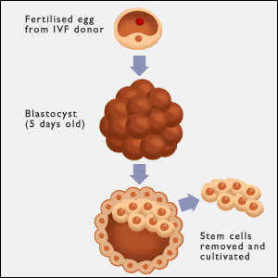
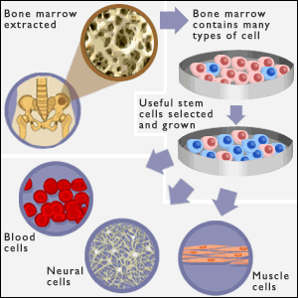
Types of Stem Cells
Embryonic
Adult

Slide 10
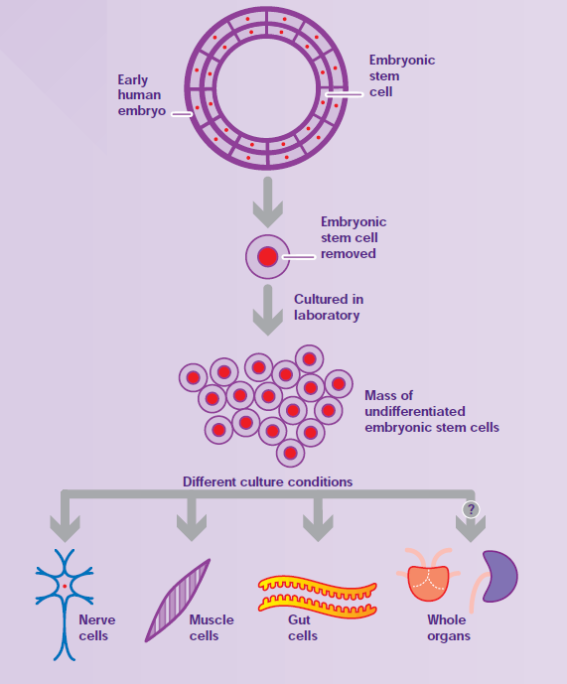
Embryonic Stem Cells
Embryonic stem cells are derived from an embryo about 4–5 days old (blastocyst).
These cells have the ability to differentiate into all of the cell types that make up an organism.

Slide 11
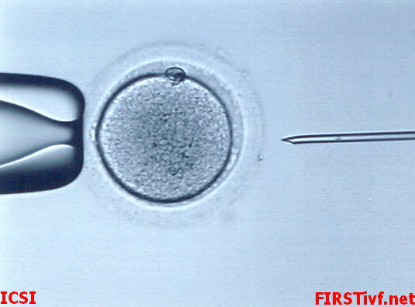
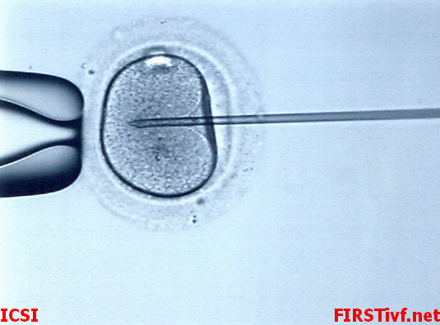
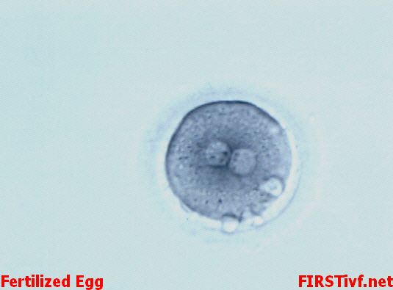
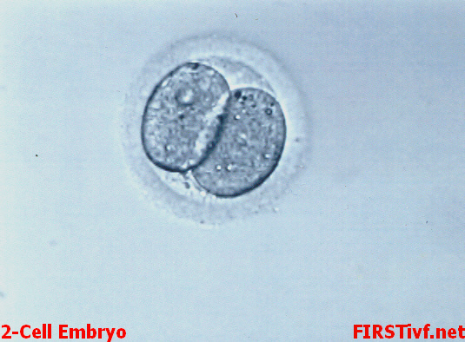
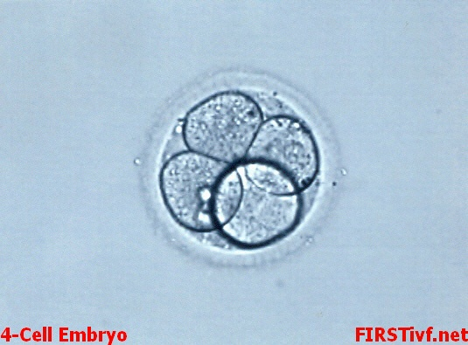
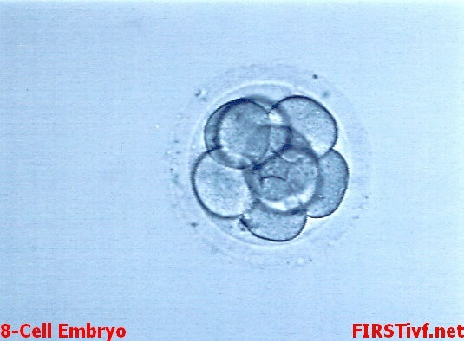
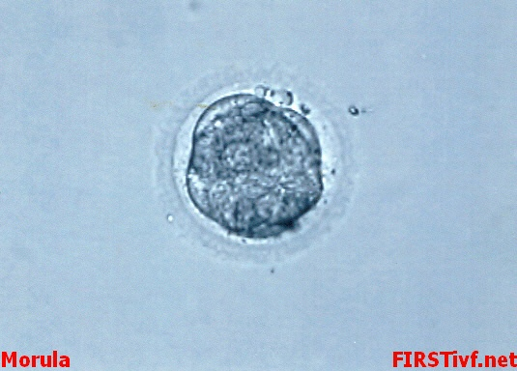
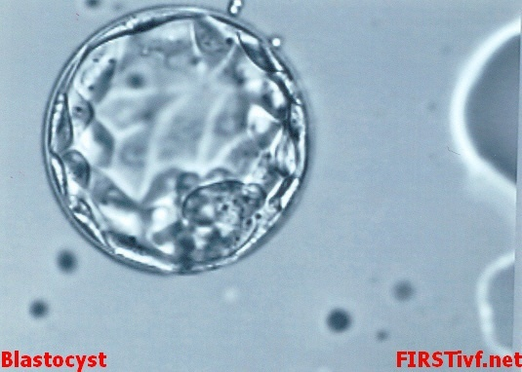
Day 1
Day 1
Day 2
Day 2
Day 3
Day 4
Day 5

Slide 12
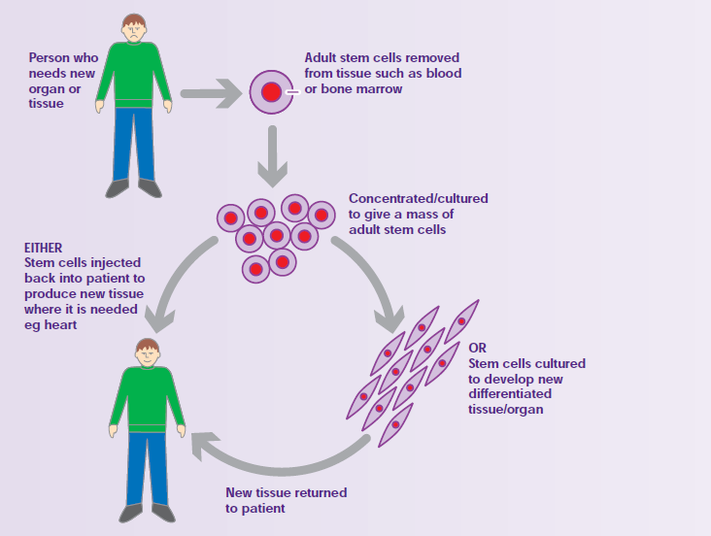
Adult (tissue) Stem Cells
Adult or tissue stem cells are found in small numbers in the tissues and organs of adults including the brain, bone marrow, skeletal muscle and skin.
These cells give rise to a much more limited range of cell types and will tend to develop into cell types that are closely related to the tissue in which they are found.
These cells replenish differentiated cells that need replaced in the tissues in which they are found.

Slide 13
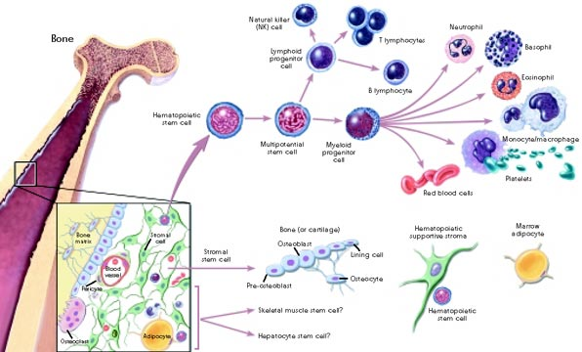

Slide 14
Uses Stem Cell in Treatments
Potential to Treat
Heart Disease
Liver Disease
Neurological Diseases (Parkinson’s, Alzheimer’s, Huntington’s & others)
Stroke
Type 1 Diabetes
Macular Degeneration (a common cause of blindness)
Cancer
HIV/AIDS
Spinal Cord Injury
Multiple Sclerosis
ALS (Lou Gehrig’s Diseases)
Currently Treated
Blood Diseases (including immune system disorders)
Genetic metabolic disorders (very limited/experimental)
Tissue/organ replacement (very limited/experimental)

Slide 15
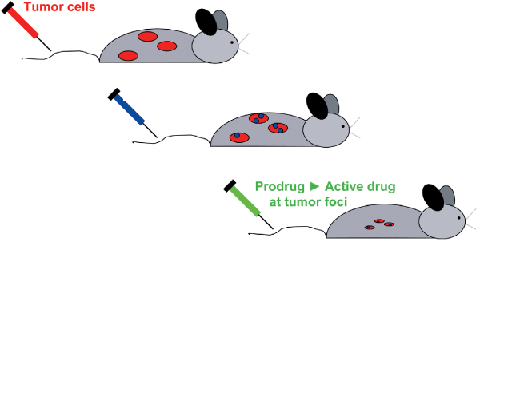
Stem cells for drug delivery Focused delivery of chemotherapy for cancer Another CIRM Disease Team
Genetically Engineered
Neural Stem Cells
Mice are given a non-toxic drug, which the neural stem cells can convert to an active drug to shrink tumors!

Slide 16
Thank You

